Slide 1
Digestion system
Part 1: nutrients

Slide 2
Major food groups
To make sure you eat an healthy diet, it is important to eat a variety of foods from the four food groups:
Grain products
Vegetables and fruit
Milk products and alternatives
Meat and alternatives

Slide 3
What are nutrients?
Nutrients are substances the body requires for energy, growth, development and maintenance.
We get nutrients from what we eat and drink.

Slide 4
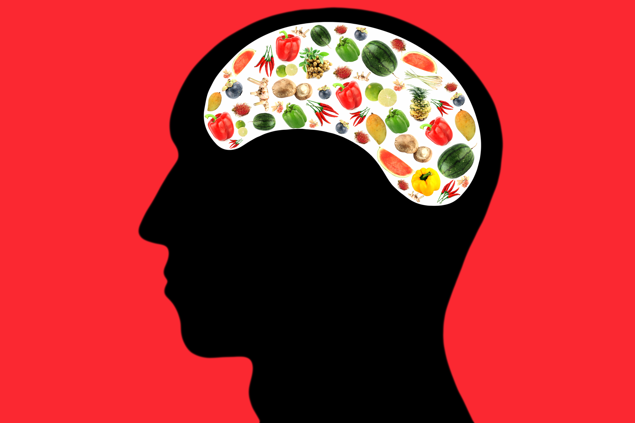
Types of nutrients
Carbohydrates
Proteins
Fats
Vitamins
Minerals
****Water**** (technically not a nutrient but very important!!)

Slide 5
Importance of Water
Is not a nutrient, but is necessary for life.
Transports other nutrients and wastes, and is necessary for many chemical reactions and for cooling the body.
Your body requires 3 to 5 L of water per day.

Slide 6
carbohydrates
Main Purpose of Nutrient: The bodies quickest source of energy
The mitochondria in your body cells change glucose into energy through the process of cellular respiration. Your body uses this energy for growth, repair, and maintenance.

Slide 7
carbohydrates
Examples of Nutrient:
Two types: simple and complex
simple carbohydrates: a Molecule of sugar (Ex. glucose)
complex carbohydrates: a chain of simple carbohydrates joined together (Ex.pasta)
(When you eat a food containing complex carbohydrates, your body needs to break down the chain into simple sugars before it can use the energy)
examples include: rice, vegetables, cereal, and bread

Slide 8
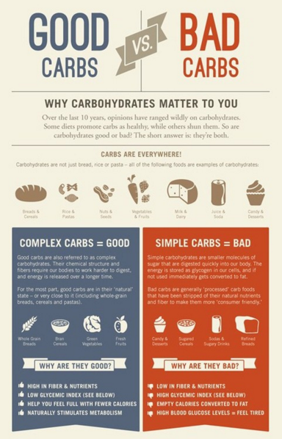

Slide 9
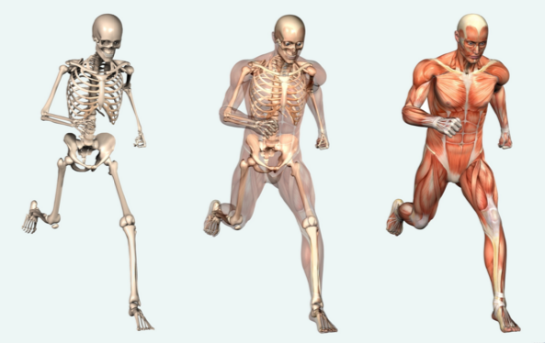
proteins
Main Purpose of Nutrient: Used to build parts of your body’s muscles, skin, hair, and nails

Slide 10
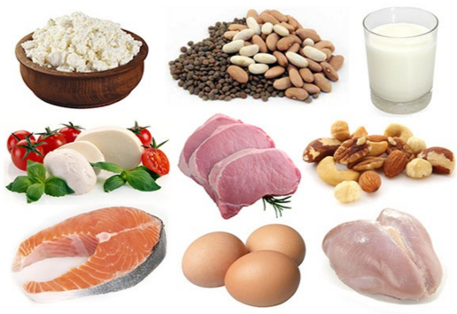
proteins
Examples of food include: fish, meats, eggs nuts, soy products

Slide 11
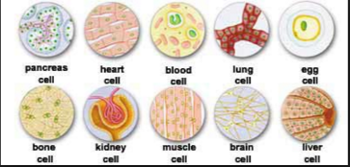
fats
Main Purpose of Nutrient: Used to build cell membranes and can be stored for future energy.

Slide 12
Fats
Two types: unsaturated and saturated fats
unsaturated fats: good fat
ex. fruit, vegetables, fish, corn oil, olive oil, and vegetable oil
saturated fat: bad fat
ex. Animal fats, such as butter or lard

Slide 13
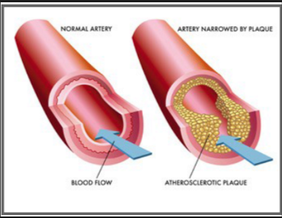
fats
Saturated fats
May cause the build-up of plaque: a fatty material that is deposited along the walls of blood vessels

Slide 14
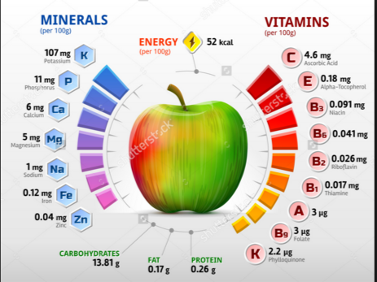
Minerals and vitamins
Needed in small amounts to perform various body functions

Slide 15
Minerals and vitamins
Two common minerals and vitamins are calcium and vitamin C
Calcium is important to help build strong bones.
Vitamin D helps the body absorb calcium.

Slide 16
Watch this!
https://www.youtube.com/watch?v=G0O87gWv-Xk

